Slide 1

Crimes in India
DEVELOPED BY
SURAJ SINGH

Slide 2
Analysis of Auto Theft Crimes in India

Slide 3
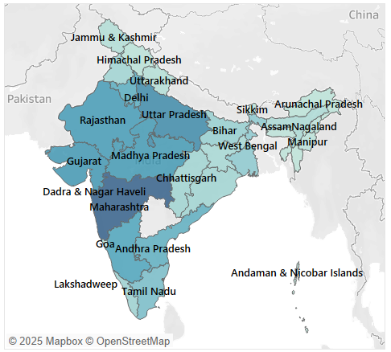
State-wise Auto Theft Crimes
Higher auto theft cases in urban and densely populated states like Maharashtra, Uttar Pradesh, and Delhi.
Maharashtra with 2,62,564 vehicle stolen
Uttar Pradesh with 1,83,116
Delhi with 1,97,330

Slide 4
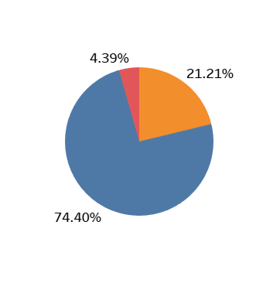
Proportion of Stolen, Traced & Recovered Vehicles
74.40% of stolen vehicles, but remains untraced.
Only 21.21% are recovered.
4.39% are traced but not recovered.

Slide 5
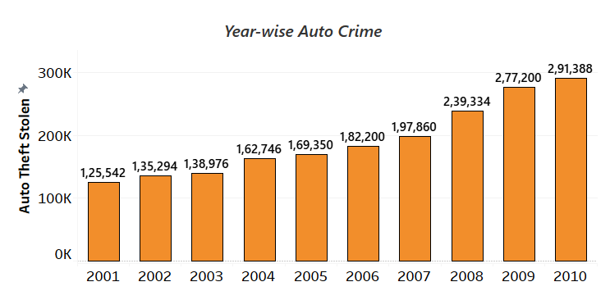
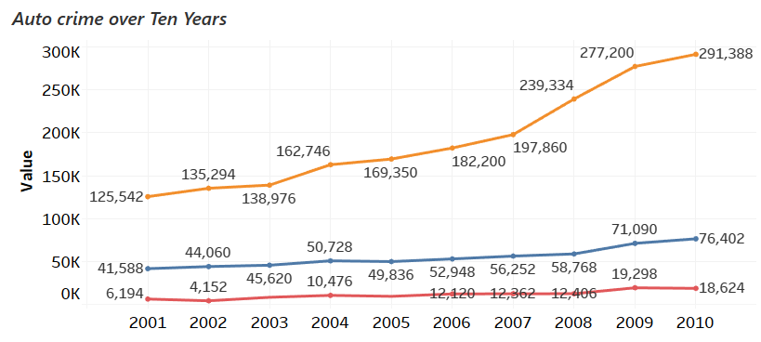
Yearly Trends
This column chart shows a rising trend in auto theft cases from 2001 to 2010.
Line Chart Tracks stolen, recovered, and traced vehicle counts over time.
Auto theft cases have steadily increased over the years, whereas the recovery rate remains low.

Slide 6
Key Statistics
Total No. of Vehicles Stolen: 19,19,890
Total No. of Vehicles Recovered: 5,47,292
Total No. of Vehicles Traced: 1,13,228
A significant percentage of stolen vehicles remain untraced or
unrecovered.

Slide 7
Insights & Improvements
Rising trend in auto theft cases.
Low recovery and tracing rates.
Certain states have significantly higher crime rates.
Strengthen vehicle tracking systems (GPS, RFID).
Improve law enforcement coordination.
Raise public awareness on vehicle security measures.

Slide 8
Analysis of Human-Rights Violation Crimes in India

Slide 9
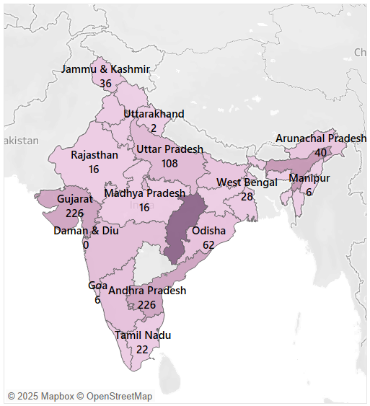
State-wise Human-Right Violations
Chhattisgarh: 624 cases
Arunachal Pradesh: 407 cases
Andhra Pradesh: 226 cases
Jammu & Kashmir, Maharashtra, Tamil Nadu,
and Gujarat also show significant numbers.

Slide 10
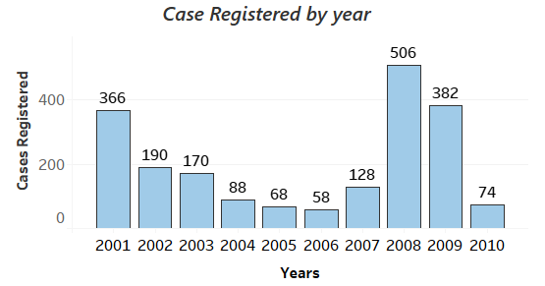
Year-wise Case Trends
Total Cases Registered per Year
Highest in 2008 (506 cases), followed by 2001 (366 cases).
Low numbers from 2004–2006.
Sharp spike again in 2008, followed by a decline.

Slide 11
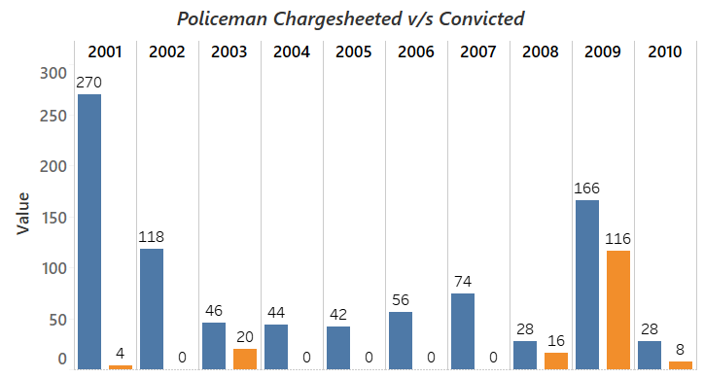
Chargesheet v/s Conviction
In 2001, 270 chargesheeted, only 4 convicted
In 2008, 166 chargesheeted, 16 convicted
Several years like 2004, 2005, 2006, 2007
show 0 convictions

Slide 12
Key Statistics
Total Cases Registered: 2,030
Total Policemen Chargesheeted: 872
Total Policemen Convicted: 164
A very low conviction rate compared to the number of chargesheets
filed.

Slide 13
Insights & Improvement
Large number of cases with very low conviction rates
Certain states are hotspots for reported violations
Years like 2008 had unusually high reporting
Strengthen internal police accountability mechanisms.
Increase transparency in judicial procedures.
Enhance victim protection and independent investigations.

Slide 14
Analysis of Rape Crimes in India

Slide 15
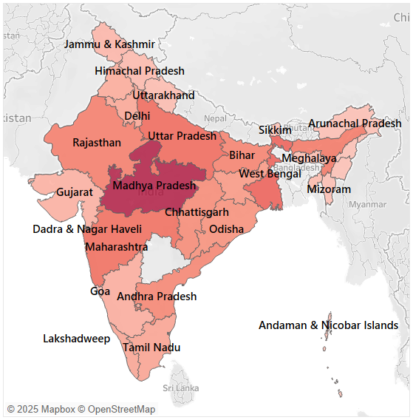
State-wise Rape Cases
It shows the distribution of rape cases across different Indian states.
High concentration of rape cases in states like Madhya Pradesh, Uttar Pradesh, Rajasthan, and Maharashtra.
Madhya Pradesh with 58,512.
Uttar Pradesh with 30,106.
Rajasthan with 23898, and Maharashtra with 28,892 rape cases.
Lower numbers in some northeastern and union territories.

Slide 16
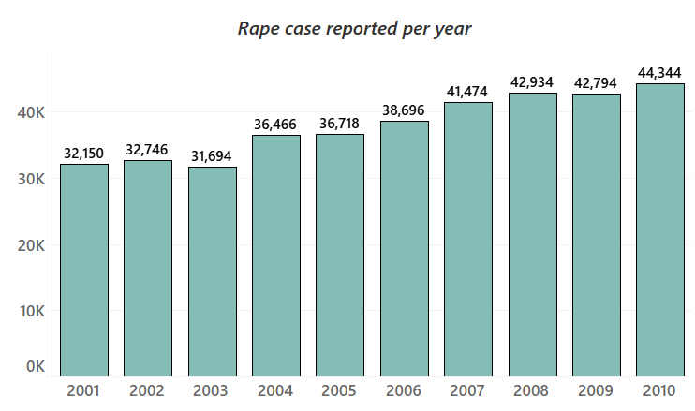
Yearly Trends
Displays the trend of reported rape cases from 2001 to 2010.
Steady increase in reported cases over the years.
Highest number of cases in 2010 (44,344).
Cases significantly increased from 2006 onwards.

Slide 17
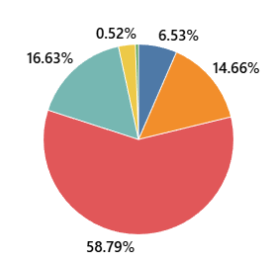
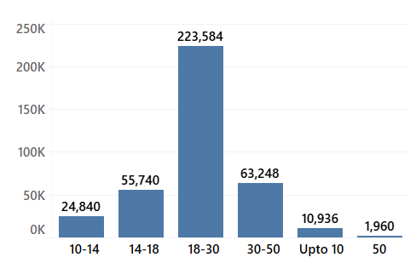
Rape Victims by Age-Group
58.79% victims aged 18-30 years.
16.63% victims aged 30-50 years.
14.66% victims aged 14-18 years.
6.53% victims aged 10-14 years.
0.52% victims aged above 50 years.
Highest no. of victims (2,23,584) in the 18-30 years age range.
Lower numbers in younger and older age groups.
Young women are the most affected demographic.
Majority of victims fall in the 18-30 years age group.

Slide 18
Key Statistics
Total Rape Cases Reported: 3,80,016
Average Rape Cases per Year: 19,000 to 22,000
A high number of cases reported, indicating the severity of the issue.

Slide 19
Insights & Improvements
Increasing trend of rape cases over the years.
Some states have significantly higher cases.
Majority of victims are young women.
Stronger law enforcement and stricter punishments.
Increased awareness and education on women’s safety.
Better support systems and reporting mechanisms for victims.

Slide 20

Thank You

